Slide 1







Spam Filter using Naive Bayes
Final project by:
Shakirkhozha Ilyas 22B030463

Slide 2





Problem Statement
Bullet points:
SMS messages can be spam or ham
Manual filtering is inefficient
Goal: automatic text classification

Slide 3


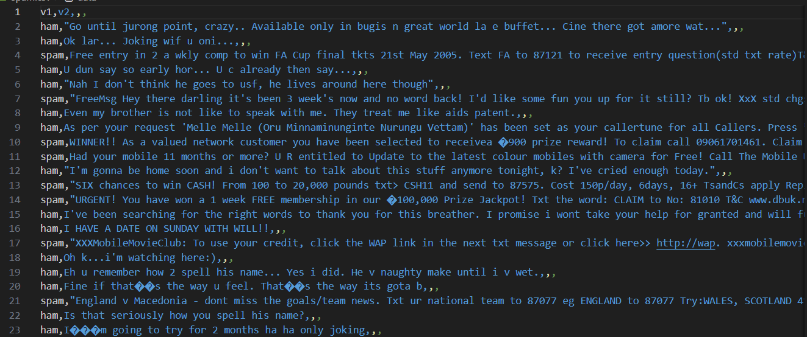
Dataset
SMS Spam Collection dataset
Two classes: spam / ham
Labeled text data

Slide 4


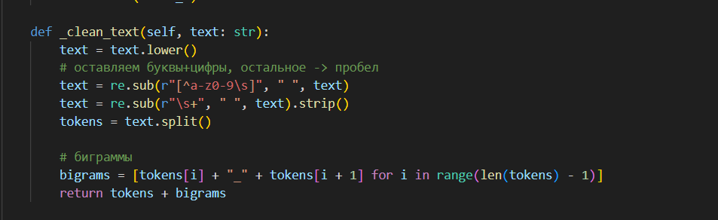
Data Preprocessing
Convert text to lowercase
Remove special characters
Tokenize messages
Generate bigrams

Slide 5


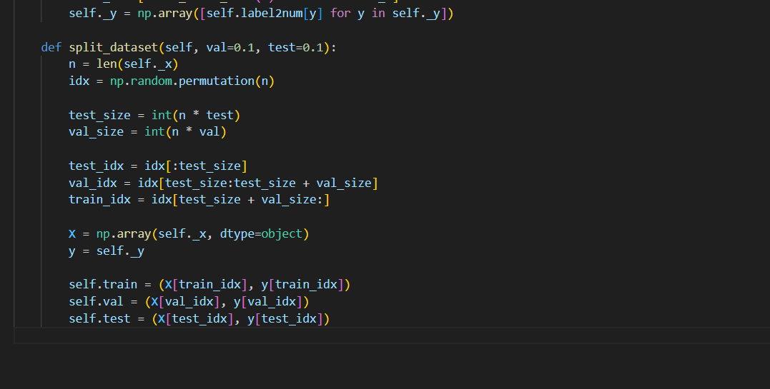
Dataset Splitting
Train set: 80%
Validation set: 10%
Test set: 10%
Random splitting

Slide 6

Naive Bayes Algorithm
P(class∣message)∝P(class)∏P(word∣class)
Naive Bayes Algorithm:
Probabilistic classification algorithm
Based on Bayes’ Theorem
Assumes conditional independence of features
Computes class probabilities from word frequencies
Efficient and effective for text classification

Slide 7
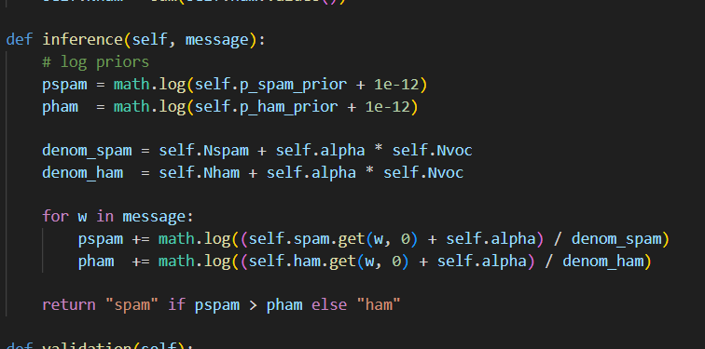


Model Implementation
Multinomial Naive Bayes
Laplace smoothing
Log-probability calculation

Slide 8


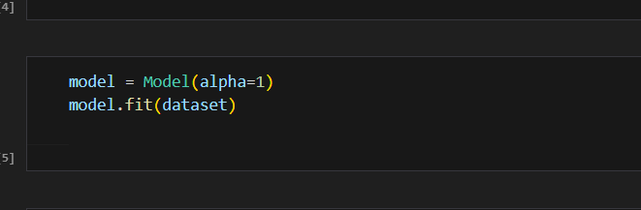
Model Training
Training on train data only
Validation and test used separately

Slide 9
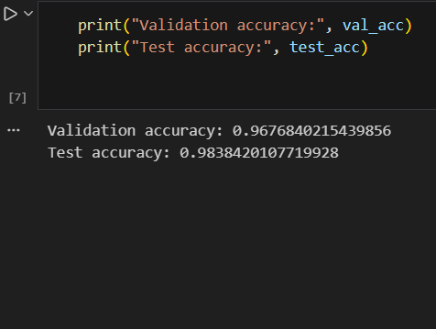
Validation accuracy: 96.7%
Test accuracy: 98.3%
Requirement satisfied
Results

Slide 10
Thank You
-

